Slide 1

Flatiron Module 2 Project: Hypothesis Testing of Northwind Database

Slide 2

Hello!
My name is Kiarash Ahmadi. I’m an aspiring Data Scientist with Flatiron Academy. I am also pursuing a Master’s in Computational Science & Engineering at Georgia Tech. My field of work is in the building energy modeling industry.

Slide 3
Project Background
Northwind is a fictional database made by Microsoft
Formulate questions that will be answered via hypothesis testing
Analysis of data is done beforehand to determine appropriate test

Slide 4
Questions to be answered
1. Does discount amount have a statistically significant effect on the quantity of a product in an order? If so, at what level(s) of discount??
2. Does customer region have a statistically significant effect on the quantity and/or price of a product in an order?
3. Does the shipping company have a significant difference on the total price of an order?
4. Do categories have a statistically significant effect on the price of products in an order?

Slide 5
Does discount amount have a statistically significant effect on the quantity of a product in an order?
Grades 1-6: Below Average
Poor construction
Simple Design
Older
Barely meets or fails to meet minimum building standards
Grades 7-9: Average
Average to just above average design and construction
Better materials in interior and exterior finish work
Grades 10-13: Above Average
High quality features and materials
Custom, detailed design
More luxurious options

Slide 6
Does customer region have a statistically significant effect on the quantity and/or price of a product in an order?
Grades 1-6: Below Average
Poor construction
Simple Design
Older
Barely meets or fails to meet minimum building standards
Grades 7-9: Average
Average to just above average design and construction
Better materials in interior and exterior finish work
Grades 10-13: Above Average
High quality features and materials
Custom, detailed design
More luxurious options

Slide 7
Does the shipping company have a significant difference on the total price of an order?
Grades 1-6: Below Average
Poor construction
Simple Design
Older
Barely meets or fails to meet minimum building standards
Grades 7-9: Average
Average to just above average design and construction
Better materials in interior and exterior finish work
Grades 10-13: Above Average
High quality features and materials
Custom, detailed design
More luxurious options

Slide 8
Do categories have a statistically significant effect on the price of products in an order?
Grades 1-6: Below Average
Poor construction
Simple Design
Older
Barely meets or fails to meet minimum building standards
Grades 7-9: Average
Average to just above average design and construction
Better materials in interior and exterior finish work
Grades 10-13: Above Average
High quality features and materials
Custom, detailed design
More luxurious options

Slide 9
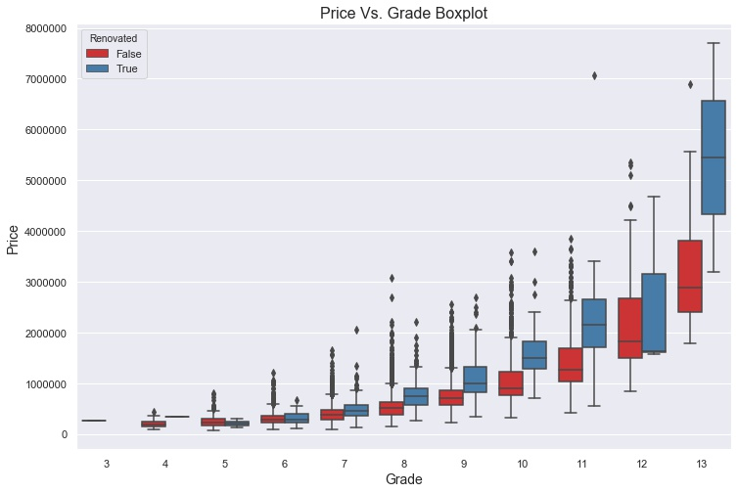
How does the quality of a house affect prices?
Model indicates that a 10% increase in an above average grade leads to a 7.66% increase in price.
Renovated homes tend to have higher values when compared to their peers

Slide 10
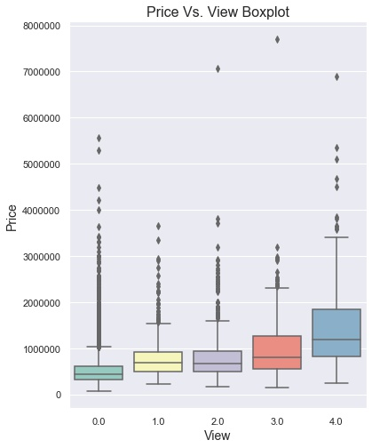
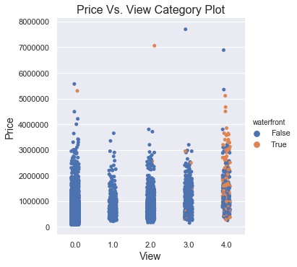
What is a view’s impact on house prices?
10% increase in views 3-4 leads to 7.65% increase in price
A 10% increase in views 0-2 causes a 3.52% increase in price.
Notes:
Mention waterfront 6.09

Slide 11
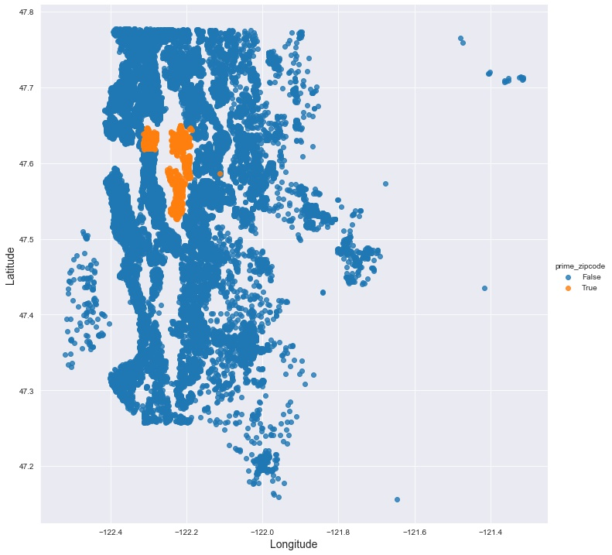
Does Location Matter the Most?
Determined the top 4 zip codes and their locations
Found distance of each house from average coordinates of houses in the top 4 zip codes

Slide 12
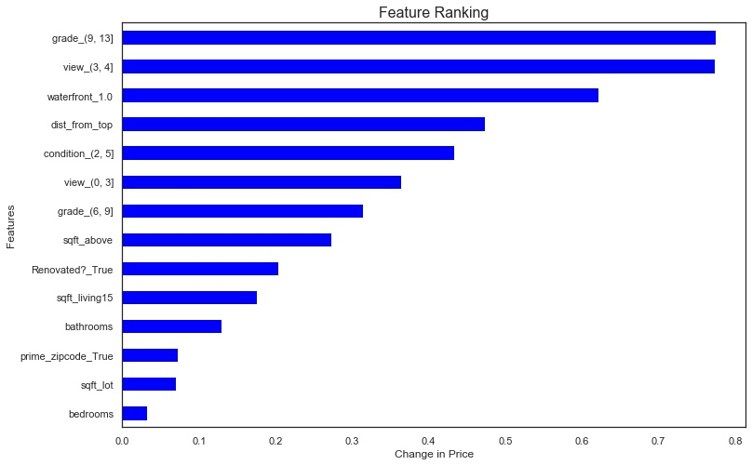
If Not, What does?
A 10% increase in distance from the top zip codes causes a 4.61% decrease in price
Grades 9-13 cause the most change in price
Square footage is less impactful than expected

Slide 13

Recommendations
Quality
Causes the most change in price when increased
View
Also has a significant impact on price
Location
Being 10% closer to top zip codes leads to 4.86% change in price
Future Work
Develop Scores
Create a quality and view score using the view, grade, renovation, and waterfront predictor variables
Quantifying Location
Improve how the model measured a good location beyond just its distance from the top zip codes.
Incorporate Interactions
Introduce new variables that account for the interactions among predictors
Notes:
2.31 quality
5.89 view

Slide 14

Thanks!
Any questions?
You can find me at:
mkiah09@gmail.com

